Slide 1
MiR collaborative mobile robots – boosting Safetey, efficiency and agility
A better way

Slide 2
Changing market demands
Pressure increases to keep
production high and costs low
Global competition
Complex supply chains
Shortage of labor
85%
of business leaders find it difficult to keep
pace with changing market demands
Source: MiR Report 2019
Notes:
We see three reasons why companies are hesitating:
A lack of clarity about which technologies will triumph
Problems implementing new technologies
An asymmetry between the length of contracts with shippers and the much-longer lifetimes of automation equipment and distribution centers

Slide 3
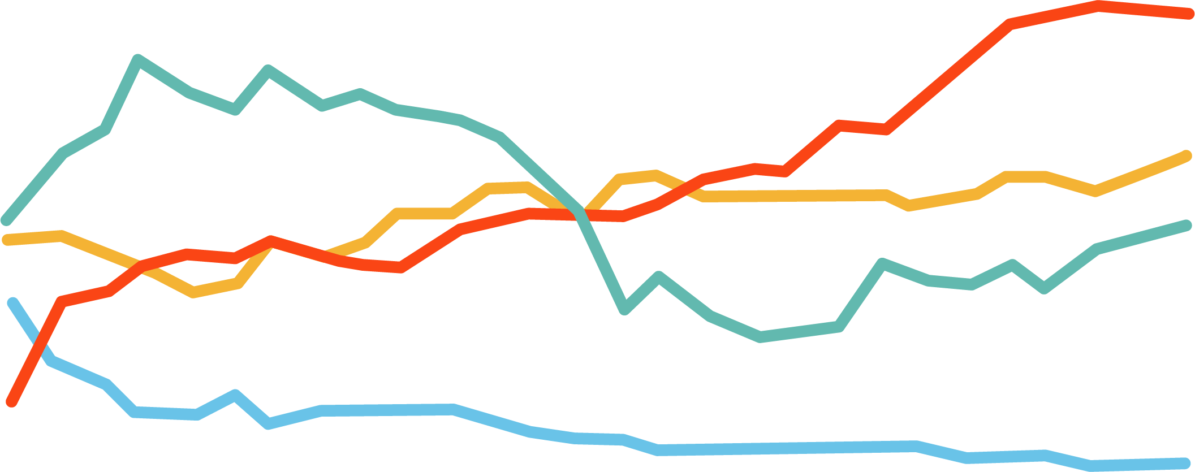
Main drivers for automating
Companies perceived risks to economic development (%)
60
Lack of skilled workers
50
Labour costs
40
Energy and raw material prices
30
20
10
Financial conditions
0
2010
2011
2012
2013
2014
2015
2016
2017
2018
2019
Source:
DIHK; Destatis, US Census Bureau, 2019

Slide 4
Trends affecting internal logistics
Trends challenging value creation across industries
Trend
Challenge
Solution
Rapid growth of new economies
and new business models
Global competition puts pressure
on continued optimization
Non-value adding material handling must be streamlined
Individualization of consumer needs demands higher variety
High switching cost and
non-flexible solutions
Engagement with adaptable, scalable, and open platforms
Growing demands and shortage of labor
Increased risk with interaction
of machines and people
Higher degree of automation with safe and collaborative robots

Slide 5
Internal logistics in the Future
=
31%
+700,000
logistic robots sold in 2022
In expected CAGR for
2020-2023
The International Federation of Robotics

Slide 6
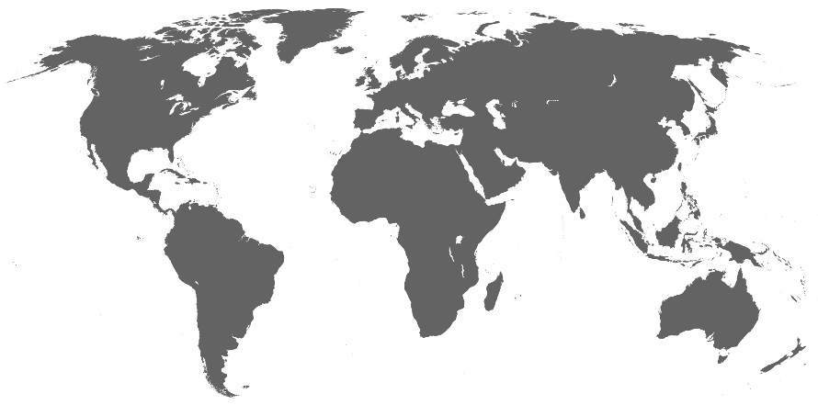
The Company Today
MiR Highlights:
450 employees focused on rapid development and growth:
45% in R&D
35% in Sales & Technical Support
10% in Production
10% in supporting functions
Born global: 220 distributors in 60 countries
Local presence: Offices in New York, San Diego, North Reading, Georgetown, Barcelona, Shanghai, Tokyo, Frankfurt, Seoul, and Singapore
MiR Office
Distributor
Award-winning technology: Winner of multiple international renowned awards

Slide 7
MiR Revenue – Fast Market Adoption
Equal to +9000 robots sold globally
7

Slide 8
Full solution provider
Expertise in what it takes to run large AMR fleets safely and reliably
Reliability: +7000 Install base and capability to enable large fleets around the world & more than 9 years in the market
Scalability: Large fleets are our specialty – we help scaling your project
Productivity & Compliance: we keep robots running and are dedicated to meeting industry standards
Robot & solution portfolio
Own Software & Fleet Manager
MiR solutions setup
Global Partner & CSI setup for integration
Flexible and global service setup
Application knowledge
World’s largest eco system to find the right solution

Slide 9
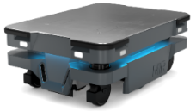
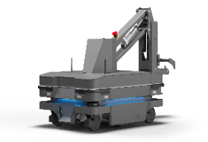
Solution Overview
Product Portfolio addresses several automation needs in your supply chain that was previously perceived unreachable
AMRs to transport small- and medium sized materials
MiR250
AMRs to transport heavy loads and pallets
MiR600
MiR1350
Top modules and accessories
MiR Lifts
MiR Shelf Carrier
MiR Hook
MiR Charge
MiR Fleet

Slide 10
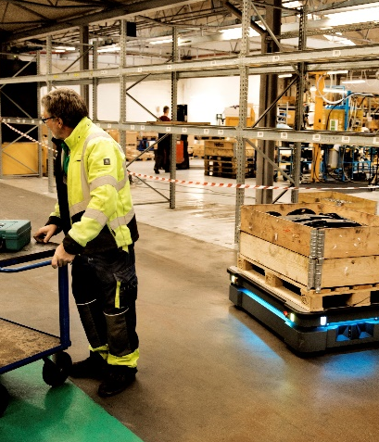
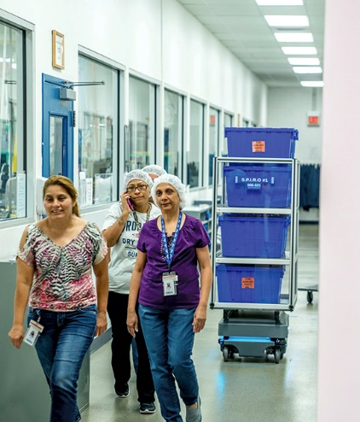
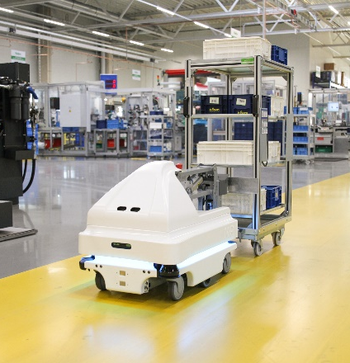
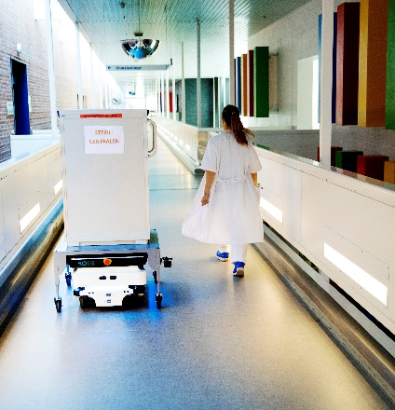
A Solution For All Industries Everywhere, where internal transportations take place, MiR robots can optimize the processes
Automotive
Food & Beverage
Electronics
Life Science
Third-party logistics (3PLs)
Consumer Goods
Hospitals
…and many more

Slide 11
Thank you

