Slide 1
Global Coverage & local insight
Mass balancing in Bioplastic certification
Notes:
ggg

Slide 2
Purpose of today
Give an introduction to the Voluntary Schemes (VS) ISCC and REDcert
Explain the principles and methods the VS provide to implement and document sustainability measures, with focus on mass balancing
Give examples on how these methods can create a basis for related claims on sustainability/bio-content

Slide 3
Agenda
Baltic Control Certification A/S
Legal framework – Renewable Energy Directive and Voluntary Schemes
Elements of certification and required documentation
Chain of Custody options: Mass balance and physical segregation
Logos and Claims Key points to take home

Slide 4
Baltic Control A/S
Maja Henriksen
Head of BCC Feed, Food & Sustainability Department
Scheme Manager for ISCC and REDcert since 2020
Auditor for ISCC and REDcert since 2019
Background in Natural Resources and Nature Management from Copenhagen Univeristy

Slide 5
Legal framework and sustainability claims
From ‘Communication – EU policy framework on biobased, biodegradable and compostable plastics’, 30 November 20222:
“Biomass used to produce biobased plastics must meet the EU sustainability criteria for bioenergy. As proposed by the Commission under the review of the Renewable Energy Directive (REDIII) of July 2021, these criteria include measures related to forest biomass and to biofuels with high risk of direct and indirect land-use change, such as those derived from palm oil. Pending finalization of REDIII negotiations, the REDII sustainability criteria for bioenergy should be applied. This is also the approach taken in the EU Taxonomy for sustainable investments for "agricultural biomass used for the manufacture of plastics in its primary form”.”

Slide 6
Renewable Energy Directive and the Voluntary Schemes (VS)
RED III
Voluntary Schemes = means to demonstrate compliance with sustainability criteria according to REDII, verified by 3. party → legit sustainability claims!
Notes:
Recognised by the European Commission (EC) to demonstrate compliance with RED and FQD.
Latest version implemented in 2021
Article 29 describes the sustainability criteria for production of raw materials (cut-off date 1. January 2008)
Biomass is not produced on land with a high biodiversity value
Biomass is not produced on land with high carbon stock
Biomass is not produced on peatland
Monitoring of impacts on soil quality and carbon
Greenhouse gas emissions calculations and savings
REDII recognises several Voluntary Schemes (VS), including ISCC and REDcert for the purpose os ensuring the implementation of the requirements in the directive

Slide 7
What do we do as a certification body?
Short presentation of the elements of certification, the supply chain and required documentation
Notes:
The requirements in the standards gives concrete tools for management and documentaion of sustainability.
What do I want to say today? What is the goal of today
Recognision of ISCC PLUS and REDcert2, voluntary schemes, authority: ISCC/REDcert,
PROBLEM: Green Washing, Legislation requirements (Green Deal)/how to document → this is a suggestion on how to accommodate new EU requirements
Context of REDII/certification, important elements of certification, presentation of context for brand owners, always keep technical information hand in hand with ‘real life’, documentation requirements

Slide 8
Elements of certification
Management system
Mass balance
Voluntary add-on:
GHG Emissions
Traceability
Notes:
Bæredygtigheden sikres gennem disse 4 nøgleområder - ved at være en del af en ISCC-værdikæde bidrager man til at bevare biodiversitet og bevaring af jorde med højt kulstofindhold.

Slide 9
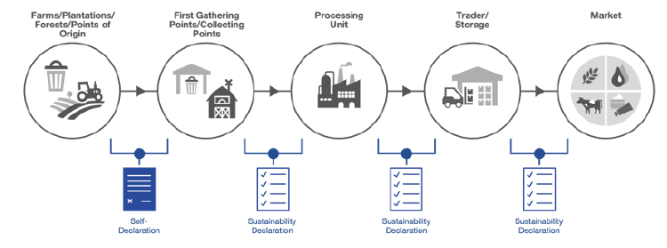
Required documentation – Sustainability Characteristics
Raw material category (bio, bio-circular, circular, renewable) The scope of certification of raw materials (the relevant declaration(s) shall be used for agriculture and waste/residues, respectively) Chain of Custody option (mass balance/physical separation) Country of origin (voluntary) Raw material (voluntary) GHG emissions (when choosing GHG add-on)
Notes:
What defines a sustainable batch?

Slide 10
Required documentation – Scope and raw material categorization
The raw material complies with the relevant sustainability criteria according to Art. 29 (3)-(7) RED II
And/or
Bio materials
The raw material meets the definition of waste or residue according to the RED II
Bio-circular materials
Maja Henriksen, Head of Feed, Food and Sustainability, Baltic Control Certification A/S

Slide 11
How do we as certification body ensure the information is correct?
Contracts
Correct classification of material (through sample audits, permits, websites, etc.)
Plausibility of amounts
Certified suppliers of raw material
Internal audit/approval process of suppliers of sustainable material
Approval of incoming documentation for sustainable material
Invoices Delivery notes such as bill of lading, CRM document, etc.
Maja Henriksen, Head of Feed, Food and Sustainability, Baltic Control Certification A/S

Slide 12
Chain of Custody options applicable under certification
Storage
Processing
Product
Mass balancing
Sustainable and non-sustainable material are mixed physically
Non-certified
Certified
Sustainable product
Physical Segregation
Non-sustainable product
Maja Henriksen, Head of Feed, Food and Sustainability, Baltic Control Certification A/S

Slide 13
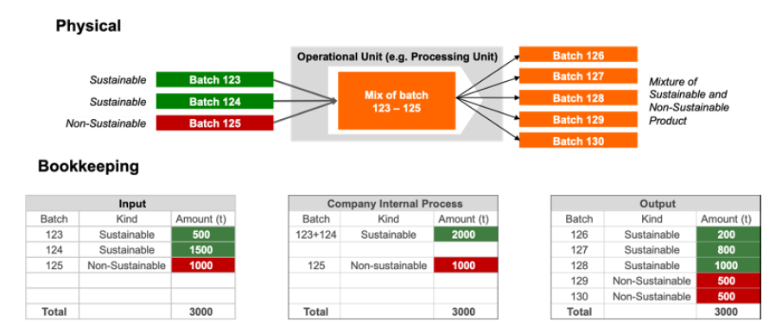
Keeping track of sustainable input in mass balancing
4/12/2023
Maja Henriksen, Head of Feed, Food and Sustainability, Baltic Control Certification A/S
13

Slide 14
Mass balance options
From Communication – EU policy framework on biobased, biodegradable and compostable plastics, 30 November 20222: “It is also important to ensure that biobased content is measured precisely. Radiocarbon based methods should be preferred as their results are robust and their use is widely accepted. Documenting the use of biomass through a chain of custody and attributing a share to end-products through mass balance accounting is a method which is not considered suitable for confirming the actual share of biobased content. Such method should be used only when it ensures a high level of transparency and accountability and is underpinned by agreed standards to avoid greenwashing”.
Feasibility?
Mass determination?
Measurement?
4/12/2023
Maja Henriksen, Head of Feed, Food and Sustainability, Baltic Control Certification A/S
14
Notes:
For all options eligible under ISCC PLUS, the attribution/ determination is
limited to:
> process outputs that can potentially contain parts (molecules/atoms)
of the sustainable input after its processing/chemical reaction (no
attribution to output, which cannot (chemically/ technically) include the
sustainable input).
> physical output (sustainable and non-sustainable) produced in the
respective mass balance period (no attribution to a quantity of
output, which is not produced at the site within a mass balance period)

Slide 15
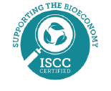
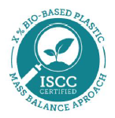
ISCC on-product logos – Mass Balanced Material
The standard version can be used without an additional claim if:
the product or packaging is made with at least 90% ISCC certified mass balanced material and
it is clear which part of the product or packaging is ISCC certified (e.g. chocolate cookies in ISCC certified recycled packaging)
If a company sources less than 90% certified mass balanced material, it is only allowed to use this version if there is an additional statement on the proportion of certified material, e.g. ‘50% certified plastic (mass balance approach)’.
4/12/2023
Maja Henriksen, Head of Feed, Food and Sustainability, Baltic Control Certification A/S
15
Notes:
Since the material is physically mixed, it is not possible to make a statement about the physical characteristics of the final product. This is why the standard version of the ISCC on-product logo for mass balanced materials emphasizes the effort of sourcing circular, bio-circular and/or bio materials.
ISCC also offers an alternative version with a percentage claim that indicates the equivalent amount of certified material sourced for the product. For the alternative version, the addition 'mass balance approach' must always be used to ensure transparency towards consumers and other third parties.

Slide 16
Key points to take home
Voluntary Schemes provides specific tools for management and documentation of sustainability according to EU Renewable Energy Directive
Different Chain of custody options (mass balance and physical segregation) for quantifying sustainable/bio-content
The Chain of custody option and/or mass balance option determines the related, legitimate logos and claims to be used

